Slide 1
The Power of People, Partnerships and Place #PeoplePartnershipsPlace #LondonsGiving
Notes:
Hello, I am Deborah
Together with my colleague Clare Thomas we have led London’s Giving for 6 years. London’s Giving is an initiative of London Funders funded by City Bridge Trust to support the development of place based giving schemes in London, inspired primarily by the success of Islington Giving.
Today I am going to talk about some key lessons from our report ‘The Power of People, Partnerships and Place’ which captures 6 years of working alongside place based giving schemes, illustrated with case studies from across London.
I am particularly going to focus on the principles which define place based giving schemes and how they have put giving schemes at the heart of their communities at this time of crisis and enabled them to work fast and effectively to mobilise resources and get them where they are needed.

Slide 2
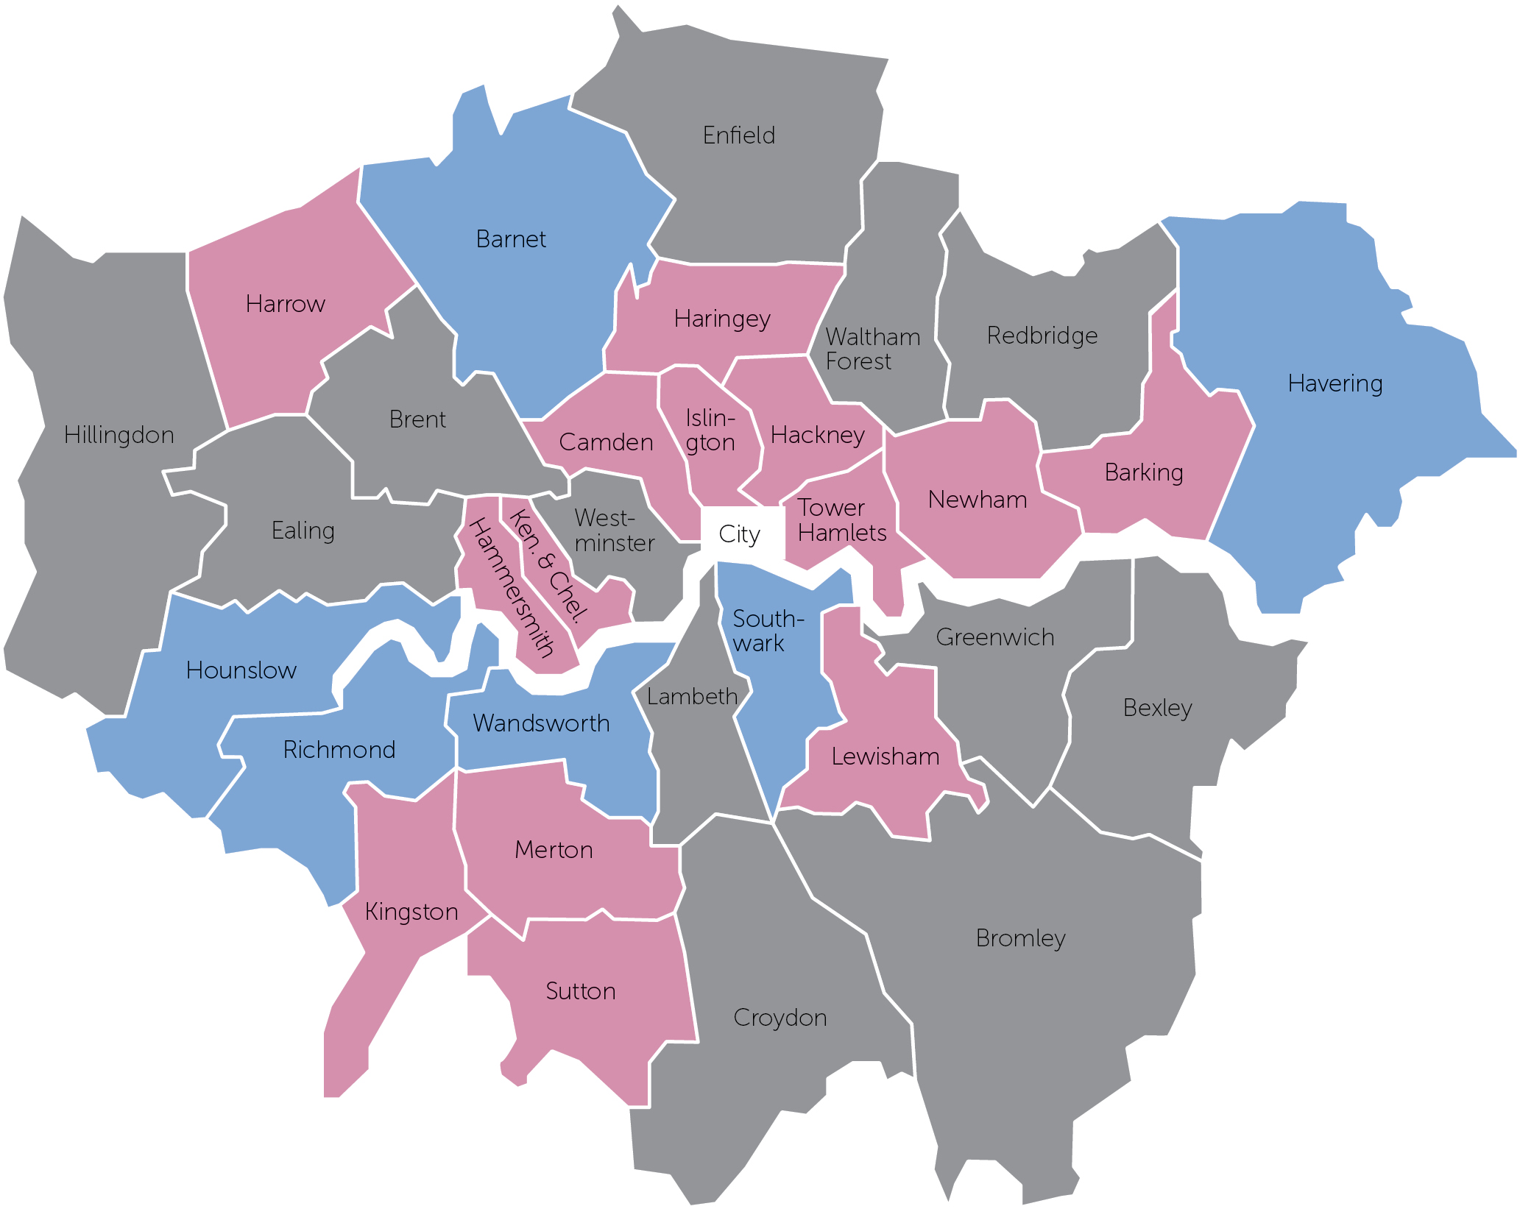
London’s Giving Movement
2017 – 2019;
£4.5m raised
£4.8m grants given
+ £1.1m volunteering and in-kind giving
March - April 2020;
£1.8m raised for Covid-19 response
Notes:
There are now 14 active and 6 developing schemes in London. We bring them together to share their knowledge and experience and we offer one to one support to staff and boards.
The schemes have been incredibly generous and open in sharing their experiences and supporting one another. This report is what we have learned from them over 6 years
Between 2017 and 2019 giving schemes in London raised £4.5m in income and gave out £4.8m in grants and over £1m in value through volunteering and in-kind giving. We asked our network to complete a short survey at the beginning of May and they told us that in less than 2 months they raised £1.8m in campaigns for Covid-19 response in their boroughs. Most of this money has already been given out, the majority were giving funding decisions to applicants within a week and giving out money within a few weeks of their campaign launches.
What does this tell us? It tells us that the principles we talk about in this report put giving schemes at the heart of their communities when it mattered most, and enabled them to act quickly and effectively to improve the lives of residents. That is what they are designed to do.

Slide 3
What is a Place Based Giving Scheme (PBGS)?
Each is unique, according to local assets and needs
Doing these things together and through partnership and listening is what makes a PBGS
Notes:
Every giving scheme is different, but they each do some or all of these activities;
Getting resources – i.e. fundraising, engaging volunteers, securing in-kind gifts – basically mobilizing the assets in their communities
Giving – grant making and brokering time and skills
Connecting – partnership working, convening and fostering collaboration
Illuminating – amplifying the voice of local people and voluntary organisations, shining a light on needs and influencing change
What they get depends on local assets and how they give it on local needs
There are examples of this throughout the report, and in the Covid-19 response we will hear more about later, but Lewisham Local is an example of how one borough has put its assets to work.
Lewisham Local has developed to focus on volunteering and micro businesses opening up their assets to the community, through a water refill scheme and access to their toilets. In partnership with Lewisham Council and 3 local charities Lewisham Local has mobilised 1,800 volunteers to provide food, befriending and help for vulnerable people during the Covid-19 crisis
Any one of these getting, giving, illuminating or connecting activities done well on its own is great, but there are plenty of organisations in London doing an excellent job of making grants or brokering volunteering or representing smaller charities. What makes giving schemes a valuable addition to the community support ecosystem is that they do these things together, listening to local people and in partnership with other local experts
Which brings me to the principles of the giving movement

Slide 4
It’s not what you do it’s the way that you do it – the principles
Everyone has something to give: time, talent and resources
Shared understanding of local aspirations and needs
Listening to local people and involving them in decision-making
Collaborating with cross-sector partners to find better ways to improve places
Independence, all partners have an equal voice
Notes:
When we gave some thought to what defines a giving scheme we realized that, in the words of Bananarama, it’s not what you do, it’s the way that you do it that defines the giving movement.
So giving schemes make People the focus of what they do by recognising that everyone has something to give – be that money, time, lived experience or skills - and by being driven always by a shared understanding of local need defined by local people themselves through consultation and participation
And they Working in Partnership with local experts and asset holders to make the most of local knowledge and resources to work more effectively in a place. Although they may be hosted initially or in the longer term by one organisation, decisions are are made collectively and all partners have an equal voice

Slide 5
The Power of Place
Place based giving helps people to make connections and take individual and collective action
Enabled by relationships built on the shared identity of place
People and businesses have shown they want to give where they live
Notes:
Now a closer look at those principles in practice. First, what’s so powerful about place?
Never has place seemed more important to us than it does now when our homes have also become our workplaces and schools, and our neighbours have become the only people we regularly interact with in person. Our physical spheres of influence have contracted to the streets and open spaces around our homes. Many of us have time on our hands and want to counteract our sense of fear and powerlessness by taking action to help others.
Of the £1.8m raised by giving schemes in March and April this year, just over £500 kcame from individual donations, and £836k from businesses. Many of the individual donations came from first time donors and many of the schemes have partnered with new funders and businesses in this short period of time.
I don’t imagine those individuals and businesses were thinking ‘now is the time to support my local place based giving scheme’, but rather they wanted to find the local experts who could get the money where it was needed as quickly as possible.

Slide 6
The Power of Partnership
At the heart of a PBGS, and its ability to do more, do better and include everyone
Partnership working and cross sectoral relationships make PBGSs the ‘go-to’ for residents, charities, local authorities and business in a time of crisis
Time and effort invested in building trust relationships enabled PBGSs to convene, connect and act quickly
Notes:
Now partnership.
Partnership is absolutely at the core of a giving scheme, and why it is able to mobilise new resources, use them more effectively and include the whole community
Most giving schemes build partnership into their working through cross sectoral partnership boards or steering or advisory groups, so that the knowledge and skills of the voluntary, public and private sectors are brought to bear on their decision making and their networks are huge and diverse.
Because of their independence, giving schemes can also convene partners around particular local needs and help to bolster collaboration with all the benefits that brings - reduced duplication, shared knowledge leading to more effective working and trust relationships which foster new ideas and approaches
Our advice to developing giving schemes from what we have observed from the best partnerships is
Firstly a broad range of partners bring knowledge, expertise and assets
Secondly, it takes time and resource to engage people and build trust, but its worth it
And thirdly, partners should be prepared to relinquish power and take risks

Slide 7
The Power of People
PBGSs that continuously listen and give away power to local people will naturally innovate and be more effective
It’s the cumulative effect of working collaboratively to give, get, connect and illuminate that creates value
Notes:
The first time I wrote this presentation for our original March 17th launch the second point on this slide about the Power of People was ‘Be prepared for things not to go to plan’ and that has been tested on a scale that I did not anticipate.
The reason the giving movement was able to be so agile and responsive to coronavirus is because they put local people at the heart of what they do.
They do this in all sorts of ways – from participative grant making at Camden Giving and Islington Giving, which you will hear more about later, to research, consultation and engagement. By constantly listening to local people and including them in decision making giving schemes can ensure they are genuinely meeting local needs, which change and evolve according to local conditions.
The challenge for giving schemes is that because of the emphasis on how (people and partnership) rather than what, giving schemes are diverse and can be complex and multifaceted. They are often run by small teams with limited resources, who have to be fundraisers and marketeers as well as facilitators, convenors, market research specialists etc, etc. But the benefit of doing these things together, and in partnership with others, is that ideas are cross fertilized, new approaches are tried and tested and decisions are made according to values, not conventions or existing structures. I recommend you go to Camden Giving’s website and read their manifesto for an example of that.

Slide 8
Key Lessons
Place matters – especially in a crisis, it brings together people and organisations across communities and sectors. Every place is unique and needs its own solutions
When people are at the heart of everything you do your work will be responsive and innovative
Building trust partnerships takes time and resource, but it pays dividends - once in place it enables you to be agile
The giving movement is a key part of the funding and community ecosystem in London, one of the most powerful tools funders and Local Authorities have to support people-led ideas and organisations
Notes:
The evidence of the response to Covid-19 has underlined the key tenets of the giving movement
Place matters, it gives a shared impetus to people and organisations across sectors to find better solutions. And it precludes ‘one size fits all’ approaches because every place is different, it demands we be inventive
As does listening to and including local people and giving them power to make decisions. This ensures the work of giving schemes will always meet local need. It’s not easy though, because it means listening to everyone and being willing to throw away old ways of working.
All of this is made possible by trust relationships which take an investment of time and skill to forge and nurture. But once they are established you will be able to make decisions quickly and call on knowledge and expertise from across sectors and that makes great things possible
Finally, the last 2 months shows that the giving movement is a key part of the funding and community ecosystem in London and a powerful tool at the fingertips of funders and local authorities to leverage their investment and support people-led ideas and projects they might not reach any other way

Slide 9
Thank you #PeoplePartnershipsPlace #LondonsGiving
Notes:
What does the future bring? It feels difficult to me to think beyond the next few weeks let alone the months and years ahead that the organisations you represent must plan for now. But I am confident that place based giving schemes know how to do it, if not exactly what will be needed yet, and our places will be better as a result.
Thank you for listening. We hope you enjoy the report and look forward to hearing what you think about it, and the next steps for us all.

